Slide 1
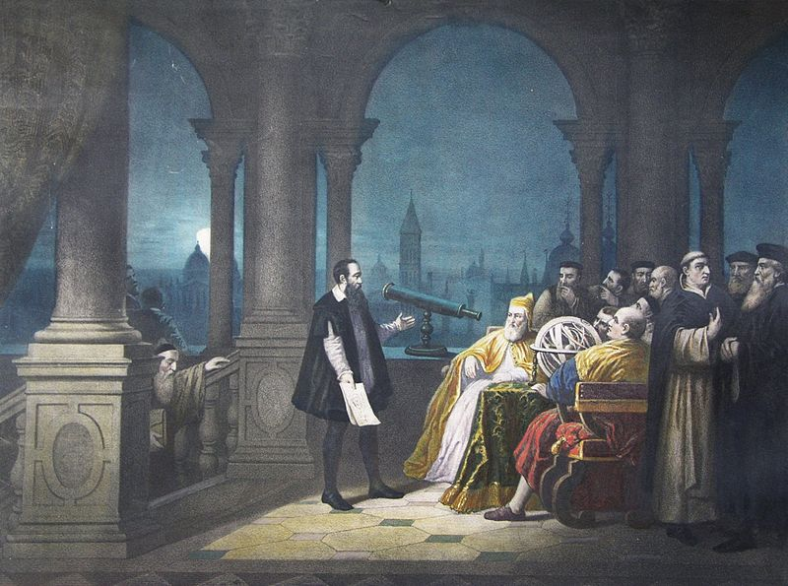
ICOS big data camp
June 5-9, 2017 Co-sponsored by ICOS and MIDAS

Slide 2
Who is everybody?
Executive producer:
Teddy DeWitt
Producers:
Jerry Davis, Cliff Lampe, Brian Noble, Jason Owen-Smith
Code Concierges (CoCons):
Nivi Karki, Ronnie Lee, Jeff Lockhart, Oskar Singer

Slide 3
What are we up to this week?
Monday: overview, SQL, project group formation
Tuesday: Python and its uses
Wednesday: Python for human language; using APIs
Thursday: Python for data analysis
Friday: write “Social capital asset pricing model (SCAPM)” app for iPhone, sell to Facebook for $10B, quit grad school

Slide 4

What does social life look like today?
Consultant running meeting on Google Hangouts
Real estate agent checking listings
Journalist applying for job
Student writing paper for class
Activist uploading files to Wikileaks
Professor grading papers

Slide 5
The job description for 90% of the people at the University of Michigan:
“Stare at a screen and type on a keyboard”

Slide 6
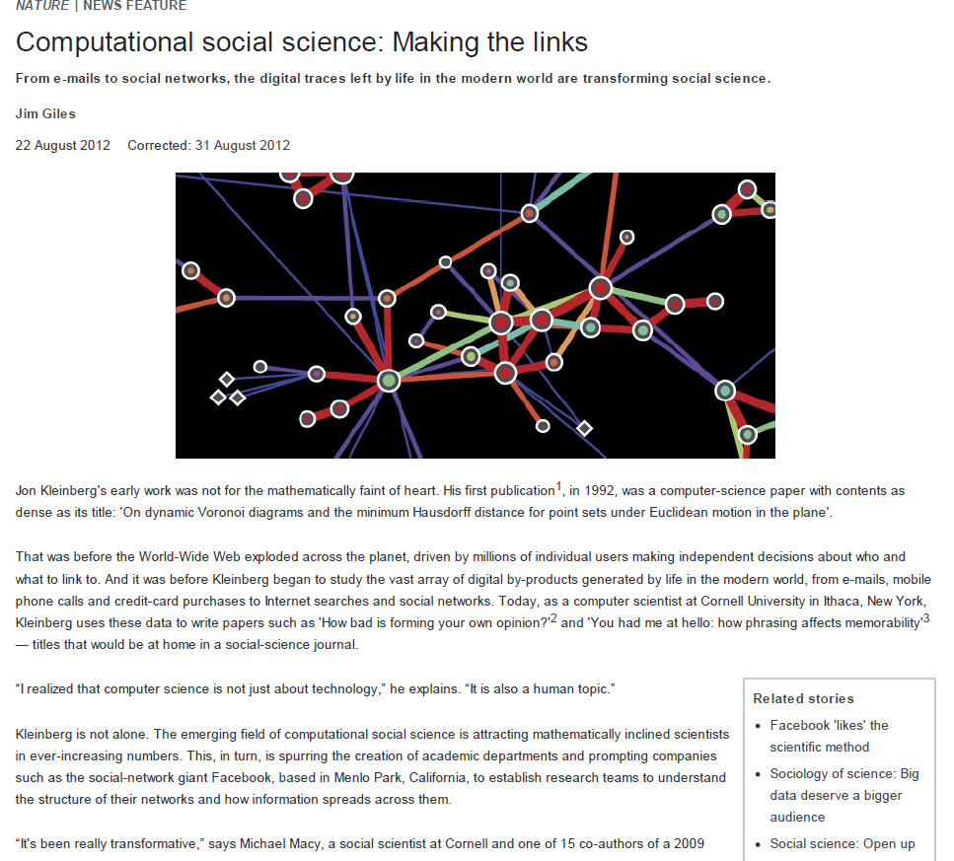

Slide 7
Thanks to ICTs, economics today is “roughly where astronomy was when the telescope was invented or where biology was when the microscope was invented.” (Robert Shiller, certified smart guy)

Slide 8
How should the pervasive “mediation” of contemporary social life affect social science?

Slide 9
Google Trends: the gateway drug for big data

Slide 10
New insights into traditional topics

Slide 11
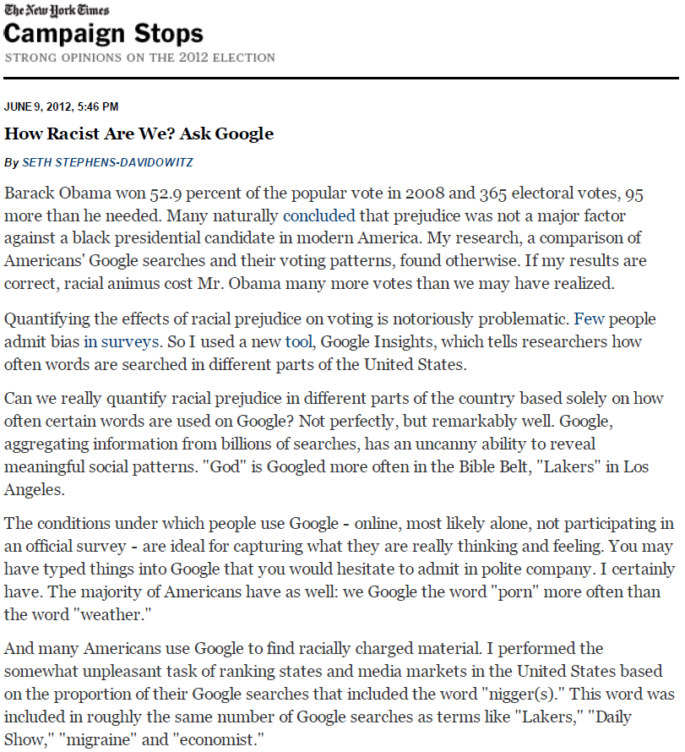
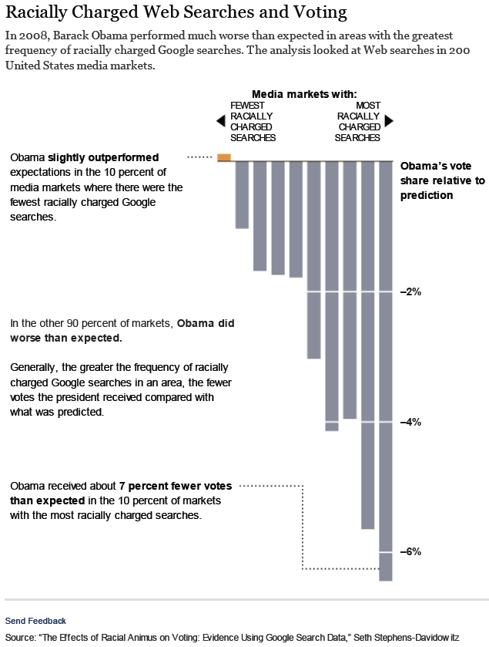
Does racism influence voting?

Slide 12
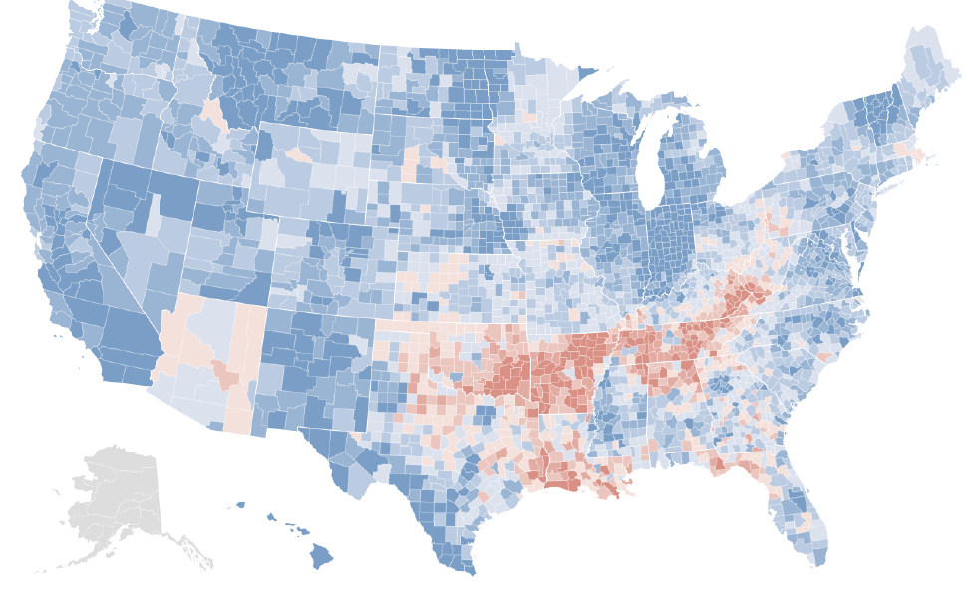
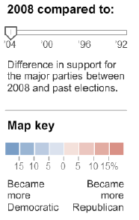
Does racism influence voting?

Slide 13
New insights into new topics

Slide 14
If only someone would come up with a way to gather horrifyingly intrusive personal information online…

Slide 16
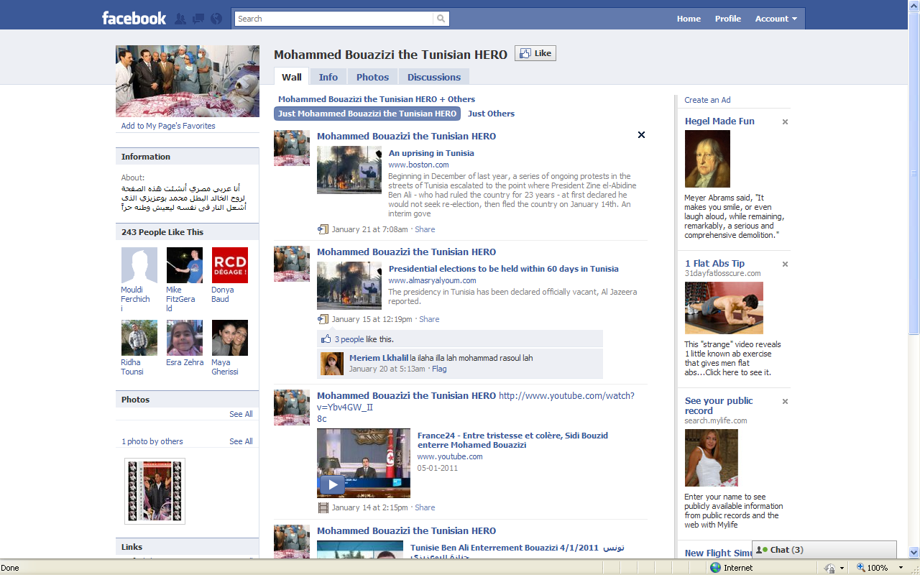
ICTs and social movements

Slide 17

One Facebook post

Slide 18
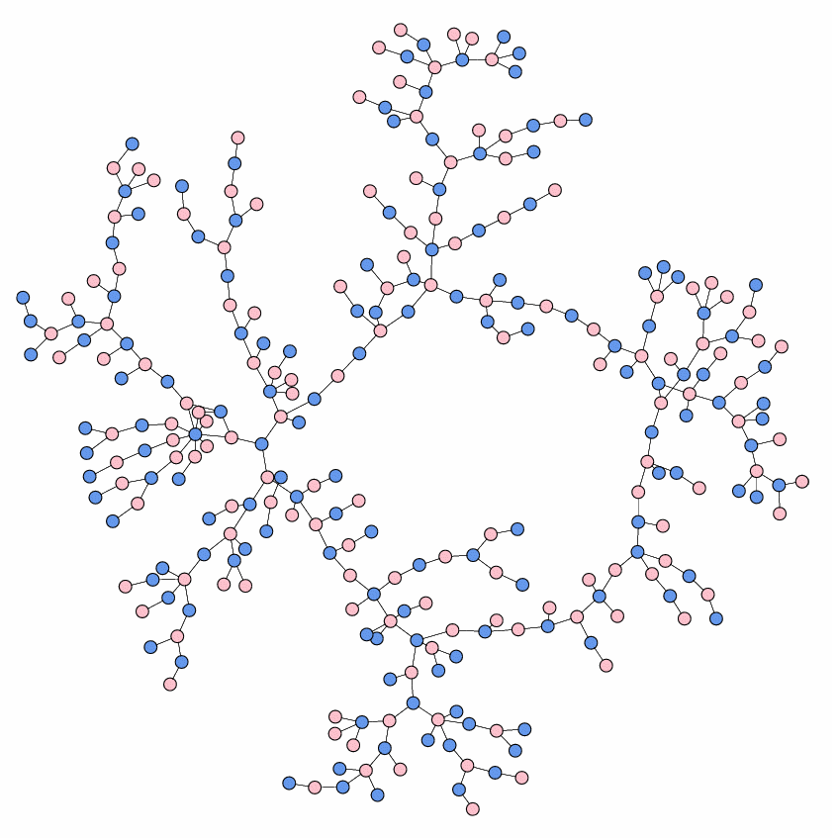
Who “dates” whom in an Ohio high school
Notes:
Ask them – 3 mins

Slide 19


Question:
Are Tinder and Grindr actually field experiments created by a rogue epidemiologist at the School of Public Health?*
*Note: if you do not know what Tinder and Grindr are, DO NOT GOOGLE THEM!

Slide 20
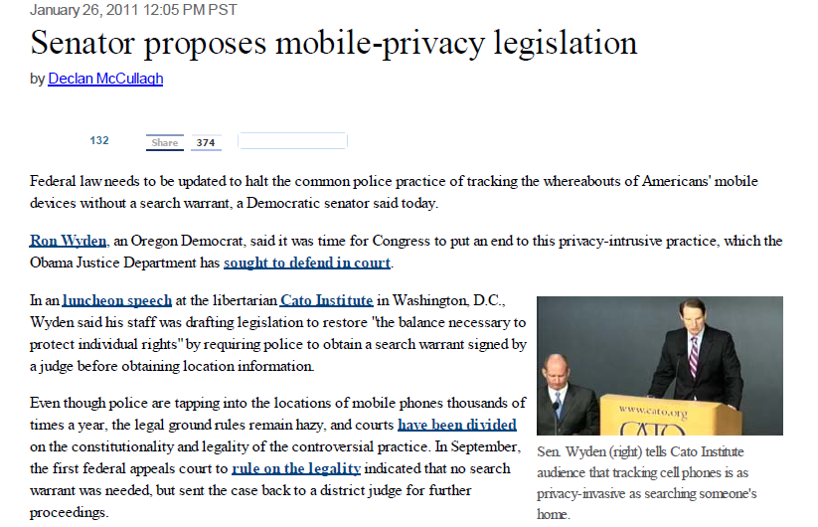
Surprising sources of network data

Slide 21
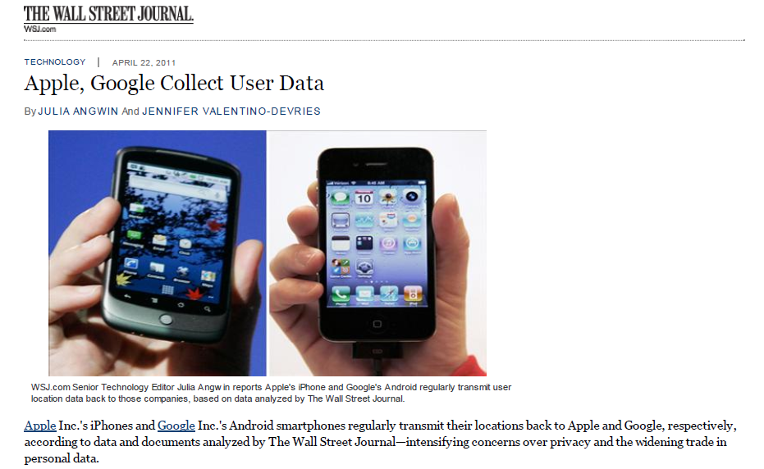

Slide 22
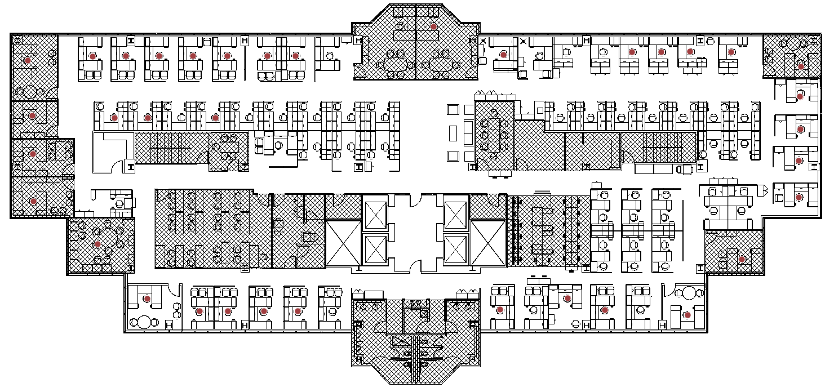
An office like yours…
Location tracking data were collected over 71 days from 40 tags
Hatched area is shadow area where signal is unreachable
Red Dots denote occupied workstations

Slide 23
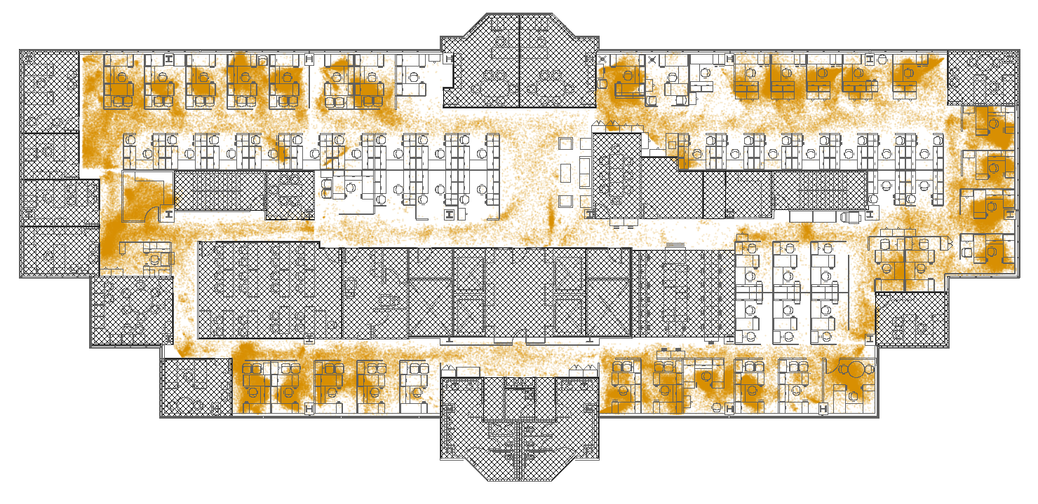
Mapped signals
The tag generates signals when the tag is moving, and goes to sleep mode when there’s no movement
The recorded signals are below (total 35 million records)
The recorded signal has the information of [tag id, x, y, t]

Slide 24
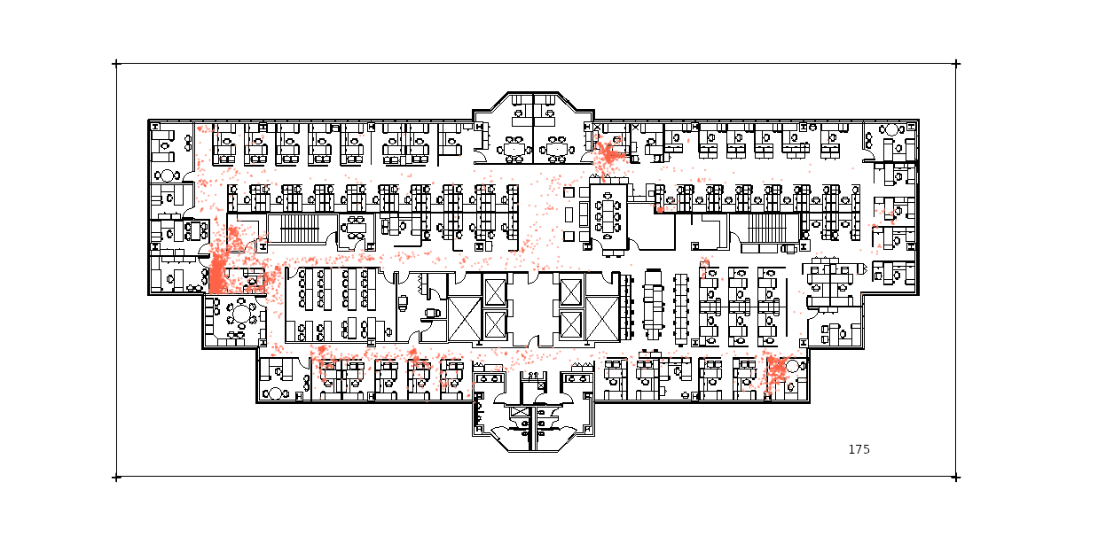
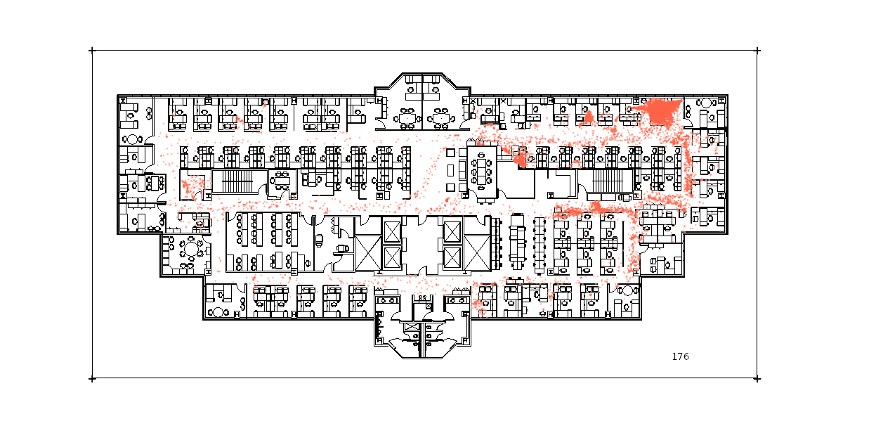
Space utilization by each person
His office is in XX area. He reports to the director so many dots in front of the director’s secretary
He leads two team and often talks with one of the team’s manager
Her workstation is obvious
She uses the copy machine often
She works closely with her team members

Slide 25
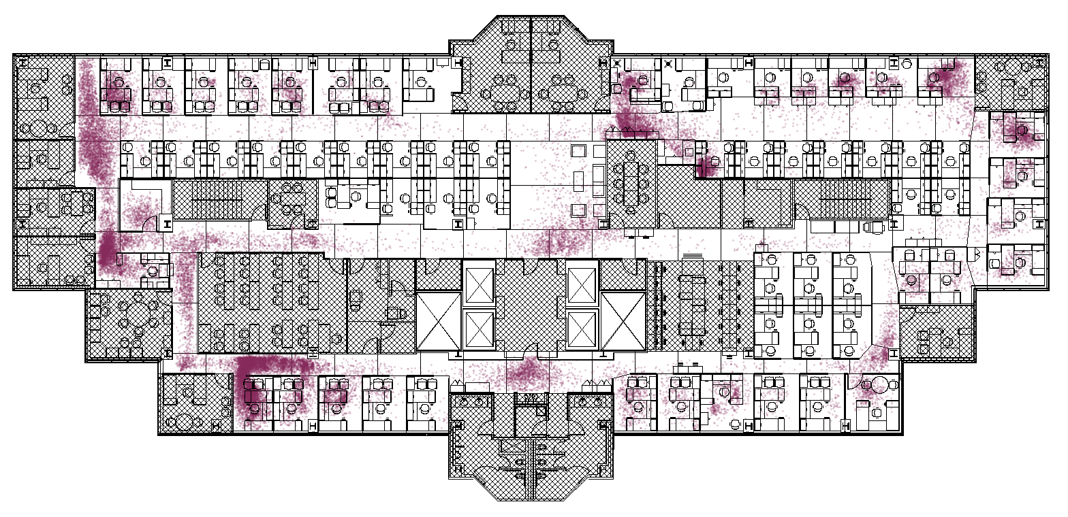
Identified interactions
Total 10377 interactions are identified.
220 interactions/day
11 interactions/day/person.

Slide 26
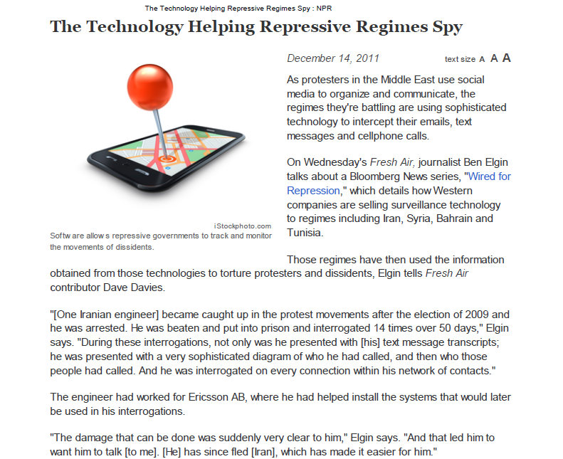

Slide 27
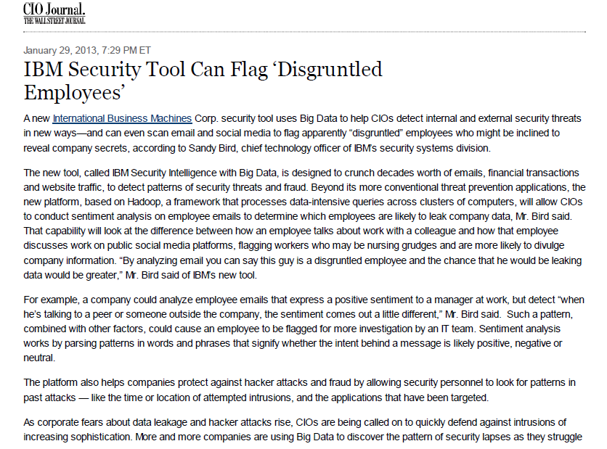

Slide 28
A deep philosophical point:
A web page does not exist until you perceive it.
(Whoah)

Slide 29
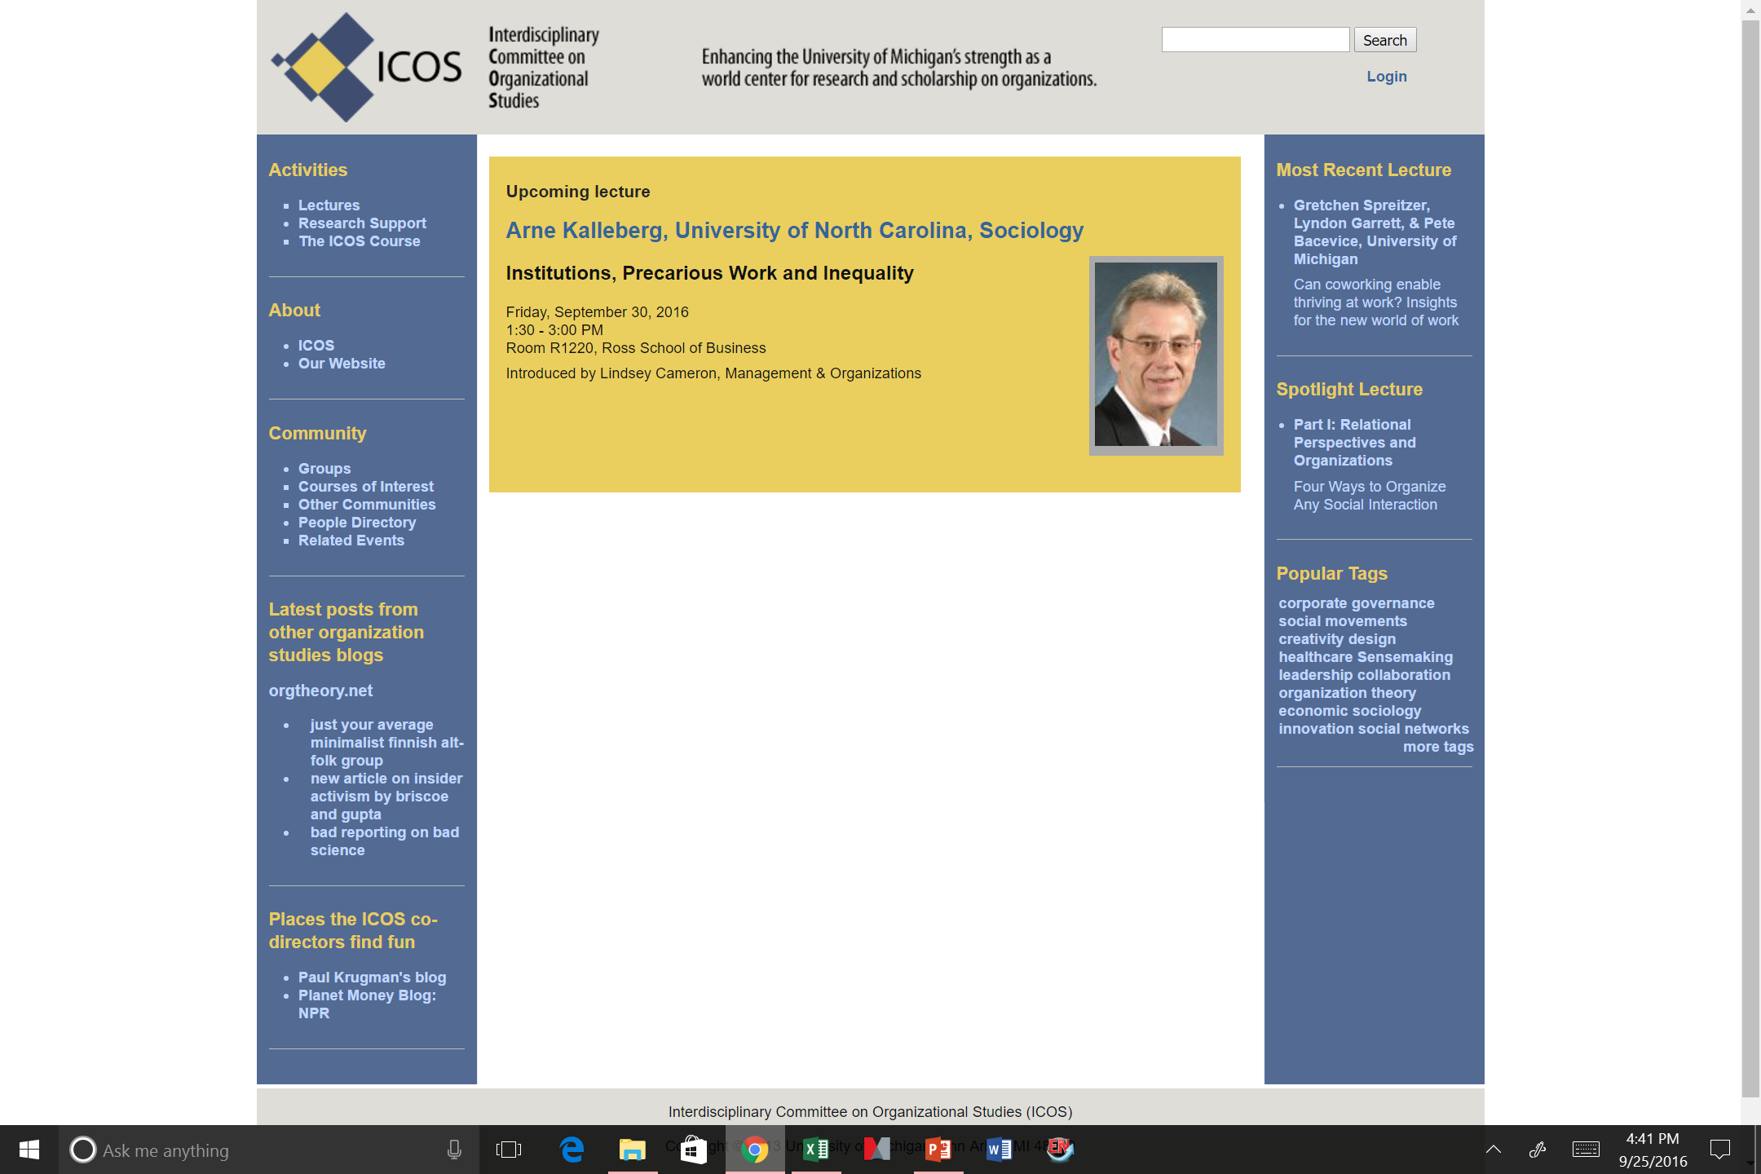

Slide 30
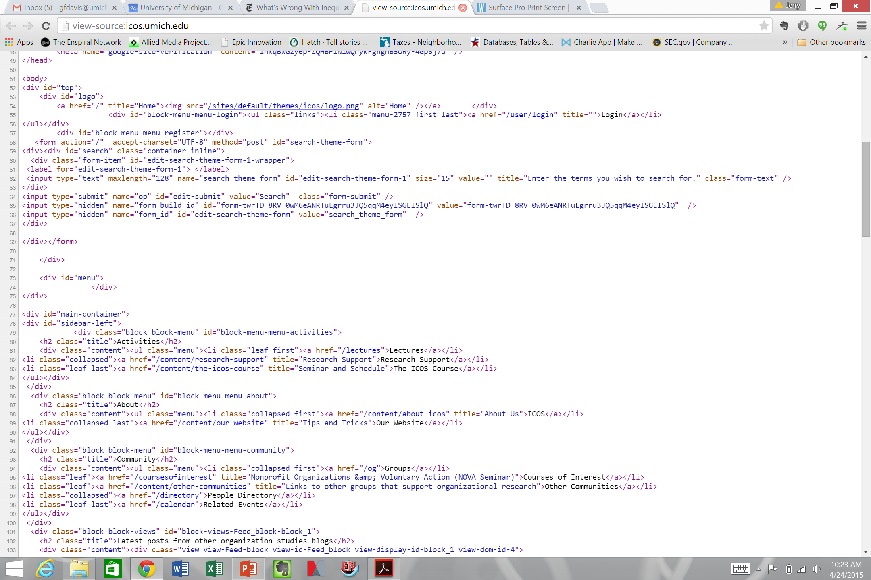

Slide 31
Some big data questions
Where do I get “big data”? Is there some secret handshake I need?
What does it look like?
How do I make gigabytes of words and numbers into something meaningful?
If I can’t learn to do everything I need about big data in a week, where can I go next?

Slide 32
How big is big data?
Visit your favorite website (e.g., www.umich.edu)
Right-click and “View page source”
Wait, what is all this stuff?
Search for http
Is there some convenient way to search through all this junk online, copy it, and drop it into a database for future use? (Will the site’s owner get mad?)
Is there an easier way to just download all this stuff in bulk?

Slide 33
A method and three tools to start
The method: learning in groups (cf. “agile software development”)
The tools:
SQL: how to manipulate those databases underlying what you see on the Web
Python: a pretty good open-source programming language
APIs: how to get them to talk to you

Slide 34
Be Not Afraid: lessons from “computer science”
Plagiarized from the estimable Prof. Brian Noble

Slide 35
We’re All Charlatans
Computer science: not a science
Few “natural laws” because it is a human construction
Exception: “This sentence is false.” (1/3 of EECS 376)
Software engineering: not an engineering discipline
Engineering: static/dynamic modeling, safety margins, etc.
Software: “Recovery-oriented computing” (1/5 of EECS 582)
A culture of decentralized collaborative tinkering
Facebook: likely the most successful company run this way

Slide 36
MOVE FAST AND BREAK THINGS
Facebook Rule #1

Slide 37
Don’t be afraid to make a mistake
Everyone makes mistakes!
I (Brian Noble) make programming mistakes all the time
Students who actually do things make mistakes as well
Professional staff at Facebook do too (obviously!)
Fundamental to the process
These are formal languages (vs. natural)
Mortals aren’t inherently great at this

Slide 38
Stay focused and keep shipping
Facebook Rule #2

Slide 39
Don’t Wait to Find Your Mistakes
Build a little, test a little
“You keep using that word. I do not think it means what you think it means.”
--Inigo Montoya
You have an important advantage!
CS students believe they are really good at this
But, no one is really good at this, just shades of bad

Slide 40
Done is better than perfect
Facebook Rule #3

Slide 41
Never Fly Solo
Two people per keyboard, always
Everyone is bad at this, but in different ways
Only one of you needs to see the problem
Trade hands-on-keyboard frequently
It’s tempting to let one person “do the work”
You lose much of the benefit this way
Talk about what you are doing as you do it
Forces you to reveal hidden assumptions
Catch some mistakes even before you make them

Slide 42
Fortune favors the bold
Facebook Rule #4

Slide 43
Practical tips
There are no new problems under the sun
Check Google
Ask your physical neighbors
Ask your virtual neighbors
Steal, do not invent!
Large community with a strong culture of sharing
Before writing something, see if someone else has
Keep versions of things around: your Lab Notebook
Explains how you got there
In case you have to “go backwards”
In case you accidentally delete tons of work

Slide 44
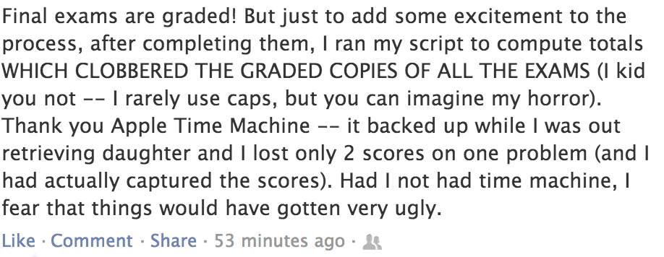
CS Professor (at another institution)

Slide 45
What would you do if you were not afraid?
Facebook Rule #5

Slide 46
A Few Caveats
You can do almost anything, but should you?
Intellectual property restrictions on code
Terms of Service restrictions on data providers
Lots of personally-identifiable information (IRB)
Computers allow you to make bigger mistakes more quickly
What is “science” vs. “stuff I saw somewhere”
Our group brought campus-wide storage to its knees
Get a sense for how this work is received elsewhere
Check with advisor(s)

Slide 47
The deliverable
Find one interesting true thing to say about your group’s topic by one week from Thursday afternoon, and explain how you got there

Slide 48
Questions so far?

Slide 49
Your Group Task

Slide 50
Use the techniques you are practicing here to collaboratively demonstrate one plausibly true thing about a topic that interests you.
Reflect on the process of demonstrating that thing
Present your finding, your process and the fruits of your reflection to the group on THURSDAY 06/11

Slide 51
Over the next week we expect you to
Form a group (to be done this afternoon)
Articulate a topic or question of shared interest
Identify and gather relevant data
Parse data and insert it into a sql database you design, pay attention to linking variables
Run queries or other analyses on your data to demonstrate your one true thing
Prepare a presentation that describes your question, your process, your findings, and what doing this taught you about working with “big data”
Have fun

Slide 52
Some examples of true (truthy) things

Slide 53
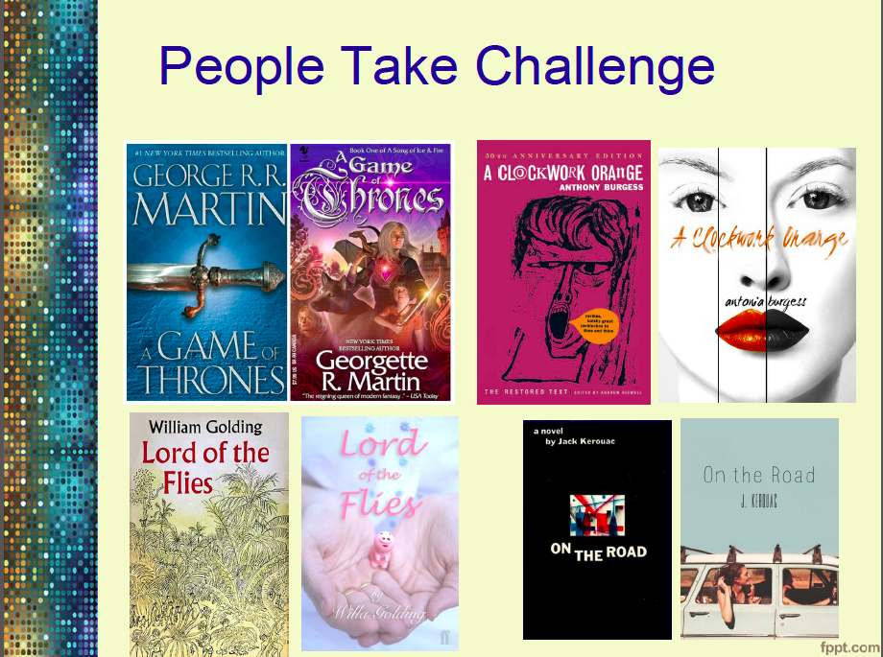
Men and women review books using different language (scraped and topic modeled data from Goodreads.com)

Slide 54
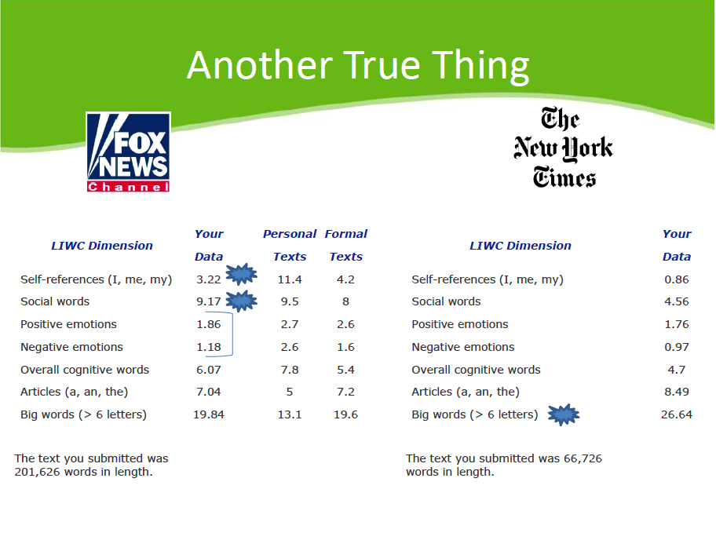
Fox News and the New York Times evince different sentiments in discussions of climate change

Slide 55
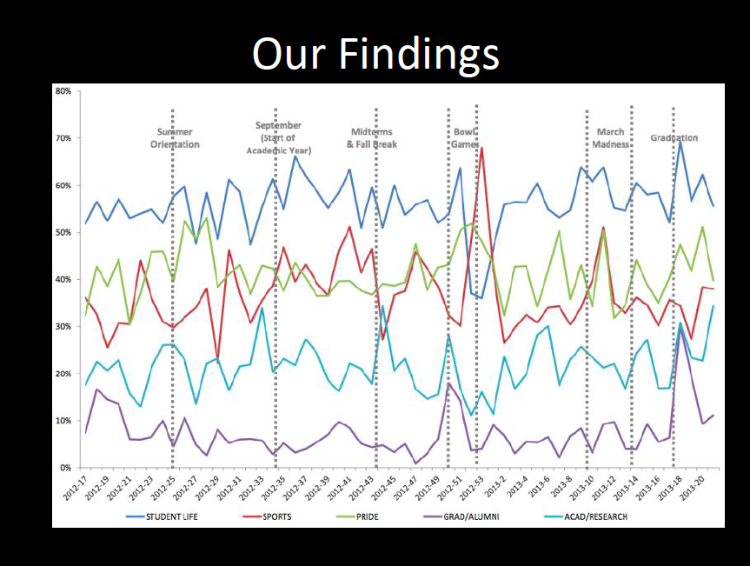
Big ten college Facebook posts mostly talk about stuff other than academics

Slide 56
How to present your true thing
Here’s who is in our group
Our motivating question was…
We tried to answer this by…
We had to completely change direction when we discovered that…
Here is our fact: ___________________
Here is how we got there and what we learned along the way

